Slide 1
WEB 322 WEB PROGRAMMING TOOLS AND FRAMEWORKS

Slide 2
Who is your Professor?
Nick Romanidis
School of Software Design and Data Science (SDDS)
nick.romanidis@senecacollege.ca
Available: Monday – Fridays, 8 AM to 4 PM
Please email your professor to set up office hours.

Slide 3
Contacting Your Professor
When emailing your professor, you will not receive a response unless you use your Seneca College email address.
Please include the course code and section code in the email subject line.
Please allow sufficient time for a response.
Consider posting to the MS Teams channel so your peers can also see your question and my answer. I invite students to answer questions when they can.
Be careful if posting code.

Slide 4
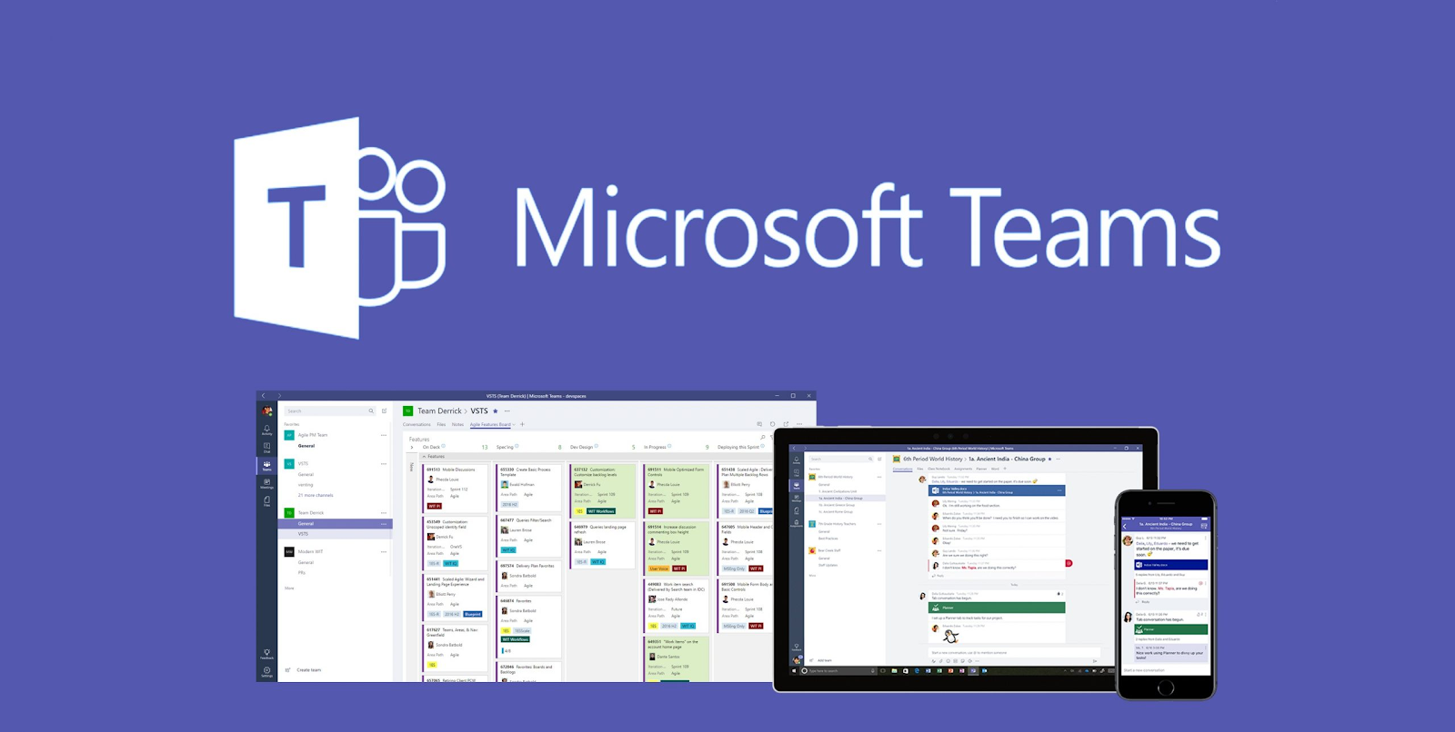
Virtual Classroom
Classes will be held as a mixture of synchronous and asynchronous methodologies.
Synchronous sessions will be held in a Virtual Classroom using MS Teams.

Slide 5
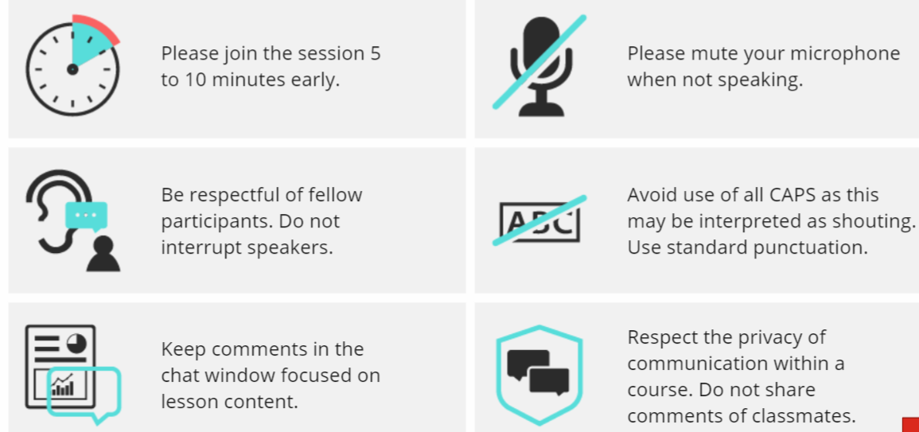
Virtual Classroom Etiquette

Slide 6
Course Overview
This course teaches students to design and create server-based web applications and services using JavaScript and other widely-used and powerful tools/frameworks.

Slide 7
Course Overview
By the end of the course, you will have exposure to several key technologies:
Overview of Modern JavaScript Syntax (ES6+)
Git and Github
Heroku
Node.js
NPM
Express
Handlebars
MongoDB
Mongoose

Slide 8
Course Notes
Every week, your professor will post new lessons.
You are expected to listen to, read and study the topics covered in the notes. Make your own notes as you follow through the lessons.
During class time, you are expected to ask questions if any topics are unclear.

Slide 9
Expectations – Do’s
You must be able to learn a significant amount of material quickly and effectively by watching, listening, reading, doing, and helping others.
What do I expect from you?
Come to and participate during the online sessions, if possible.
Participate - ask and answer questions.
Be organized.
Be prepared for class:
Read the class notes and links. They are provided ahead of the class.
Make your own notes, including any questions that you may have.

Slide 10
Expectations – Don’ts
Don't fall behind.
Don’t procrastinate on your assignments:
Read and try to understand the current assignment.
Get started on assignments as early as possible.
If you’re stuck, ask for help.

Slide 11
If you’re stuck
You will encounter problems and delays while coding. When you do, here are a few tips that may help:
If you can’t solve the problem within 20 to 30 minutes, then stop and set it aside. Grab a coffee, take a walk, clear your mind, then come back to the problem again later.
Chances are, others have seen your problem. Search on Google, Stack Overflow and other online forums.
Ask your professor or a classmate, post a question on the MS Teams channel. Don’t thrash or attempt to ‘wrestle the problem to the ground’. Others will not think any less of you when you ask for help.

Slide 12
Online References
Each week, material will be provided in the form of links, whitepapers, and code walkthroughs.
Students are expected to use these materials extensively during the semester.
If you need more, the internet is a great resource.

Slide 13
Grading Overview - Tests
There will be 6 tests.
Your top 5 quizzes will be counted toward 50% of your final grade.
Tests will be written on Fridays during weeks 3, 5, 7, 9, 11 and 13.
You may begin your test starting at 12:00 PM (Eastern Time) on Friday and must complete the test by 12:00 PM on the following day.
Once you start a quiz, you will be allowed a specific amount of time to complete it.
Tests may include any material covered since the start of the semester however there will be a greater emphasis on the material covered more recently.

Slide 14
Grading Overview - Project
Project
The project is broken into 6 assignments, worth 50% of your grade.
Assignments will be posted on the course website as they become available.
Assignments handed in late will receive a 50% deduction.
Assignments more than seven days late will receive a mark of zero.
Submissions that do not meet specifications may be returned to the student for revision and resubmission.

Slide 15
Grading Overview – Midterm/Final Exam
Midterm exam
There is no midterm exam for this course.
Final exam
There is no final exam for this course.
Grades
Your grades will be posted on Blackboard.

Slide 16
Evaluation
Project 50%
Tests (Top 5) 50%
---------------------------
Total 100%
Promotion Policy: To obtain a credit in this subject, a student must:
Achieve a passing grade on the overall course.
For more information, please review the course addendum posted on Blackboard.

Slide 17
Academic Integrity
Please read the Academic Integrity Policy available at: www.senecacollege.ca/about/policies/academic-integrity-policy.html
Help each other by answering questions but don’t copy and paste.
Never share your code with others
Hands off someone else’s mouse and keyboard / screen share.

Slide 18
Getting Started
Familiarize yourself with the course website (on BlackBoard). The website contains the professor’s contact information, important announcements, lecture notes, assignments, and your grades.
Set up your development environment. Please see the Getting Started page on Blackboard.

